Slide 1
Fabrikam Foods
<Ziwei Liu>
<st_smarty_pants@hotmail.com>
Notes:
Please enter project details and your details here.

Slide 2
Bit about myself
Psychology, Education, Philosophy, Marketing, Design
Double Major Neurology and Computer Science (Honours)
Developer / AI / Computer Science Education?
Notes:
This section is NOT assessed. We just want to get to know you ☺.

Slide 3
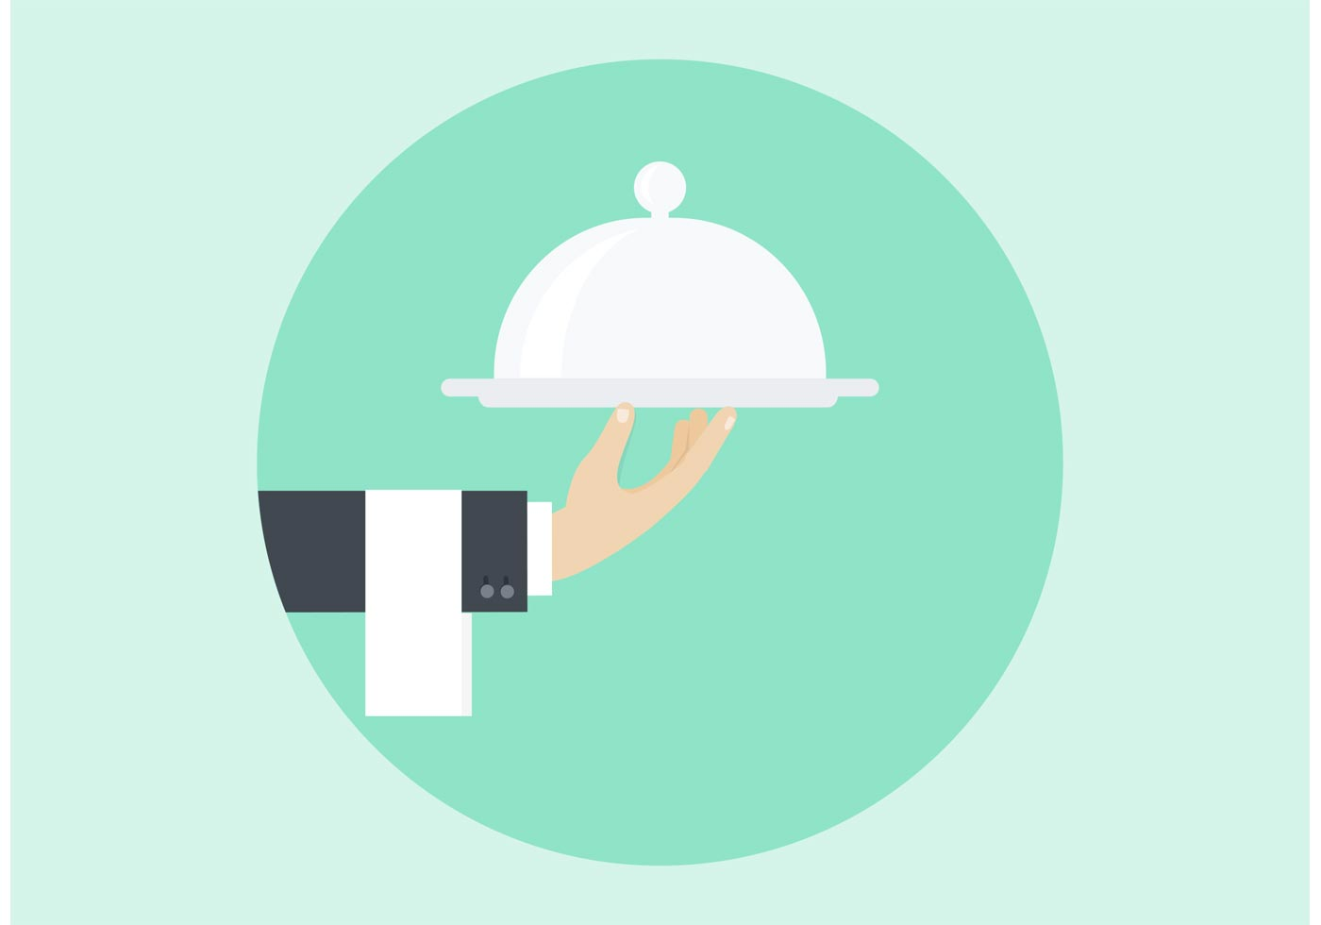
User Experience
Phineas the Fabrikam Butler
Classy but sense of fun
How old is this guy anyway??
Still don’t know why a restaurant has a butler..
Tells you bit more about himself each sign-in
“I’m hiding on purpose, sir. I’ve been called quite a looker back in the day - wouldn’t want to distract the waitresses”.

Slide 4
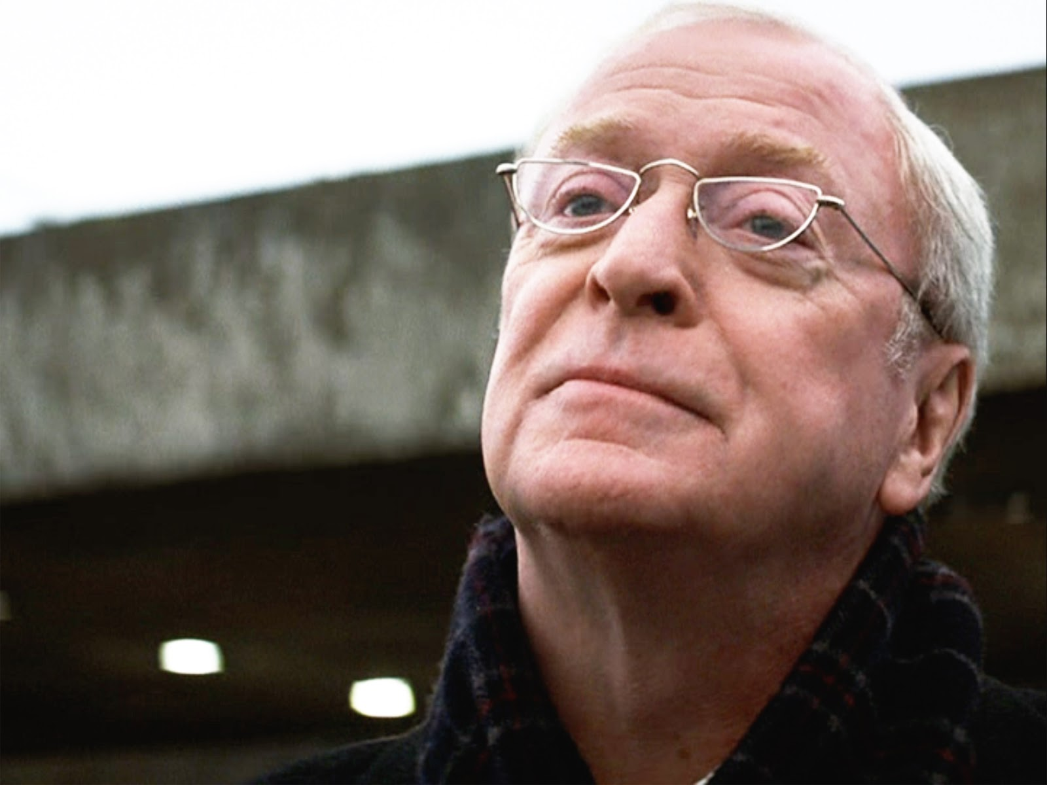
Branding & Business
Personal butler
Trust with personal information
Natural User feedback
Build a community around the lore?
Messenger
https://www.messenger.com/t/PhineasFabrikam

Slide 5
Bot Implementation
Cognitive Recommendations API
User State Service and Google Geocoding API
Integration with FB
Receipt Card & update data
Authenticate
Order food
Order drinks
Check if available
Delivery address
Payment
Confirm order
Carousel Hero Cards
Read database “butlerbrain”
Connect to payment API of some sort
LUIS Natural Language Processing
Notes:
Explain your Azure features here

Slide 6
Databases & API
Tables for food and drinks
References to name, price, quantity, image and description
Shopping Carts?
Google Geocoding API
Recommendations API
Notes:
Talk about your database, what schema you used and what data you used

Slide 7
Final Comments
Notes:
Any final things you want to tell us

